Slide 1
PIXNET Hackthon
Team: MY_SK_ll

Slide 2


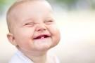

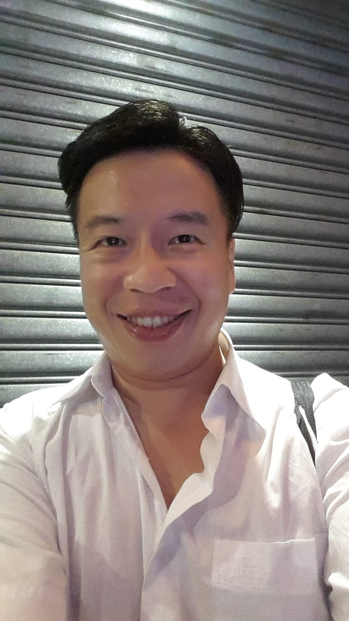
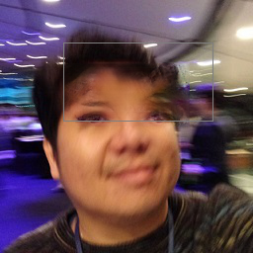
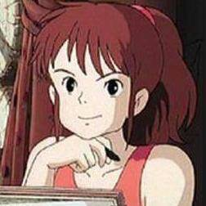


MY_SK_ll ....who we are
senior
junior

Slide 3
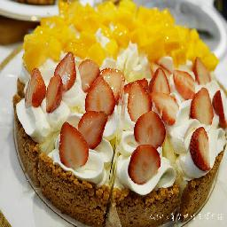
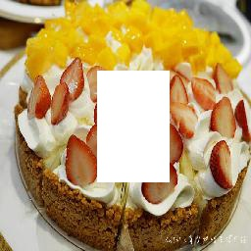

The Problem
hope
Radom Crop

Slide 4
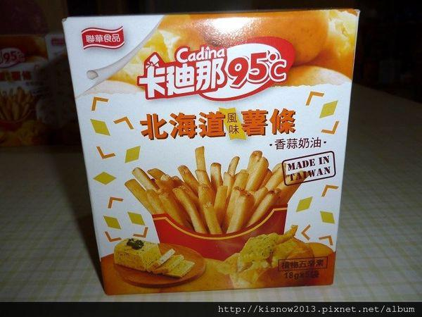
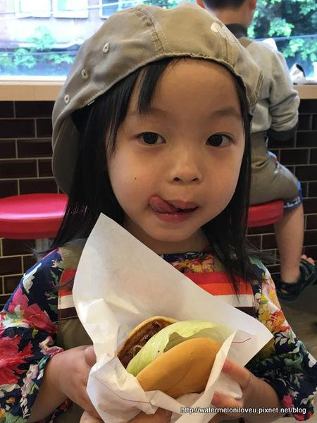
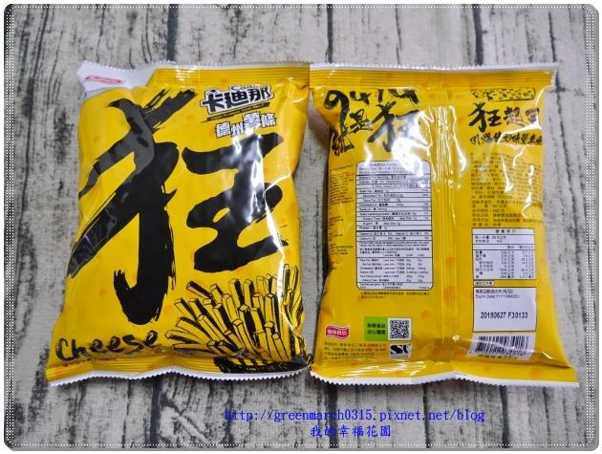

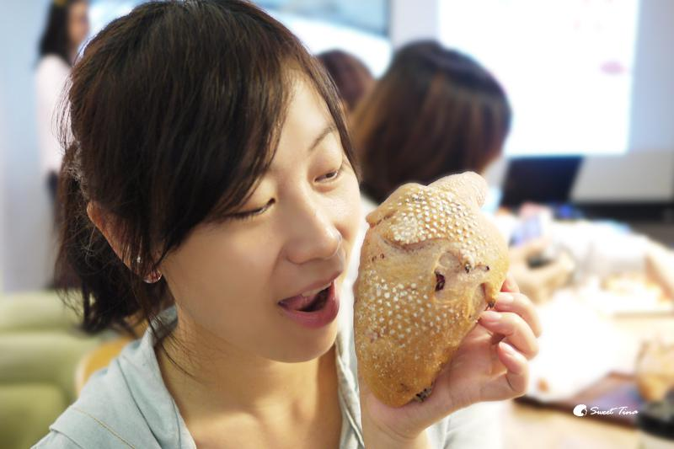
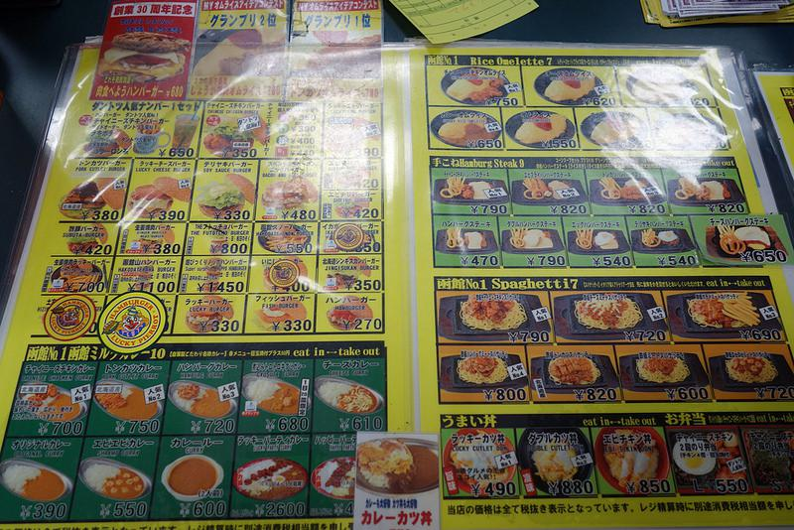
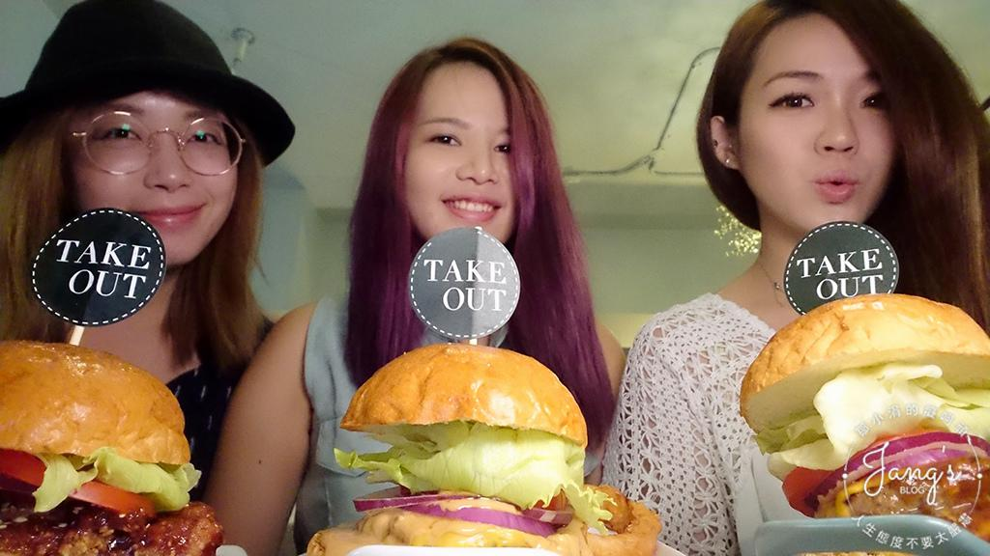
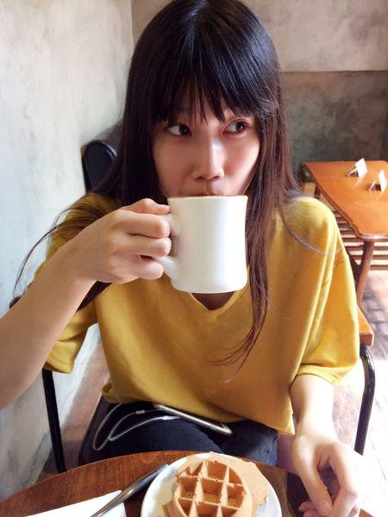
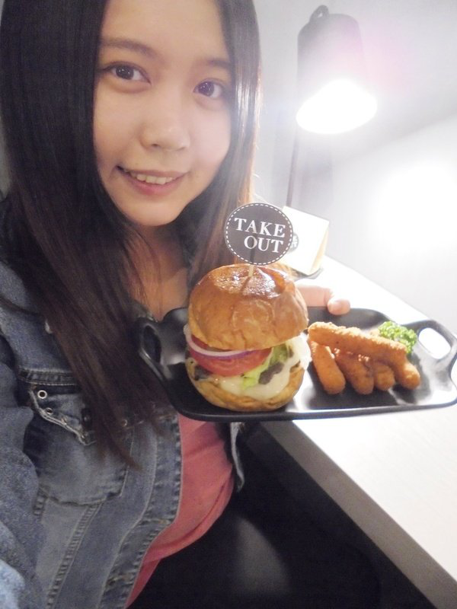
First thing first..Cleaning
18,548 -> 12,462 Training Data

Slide 5
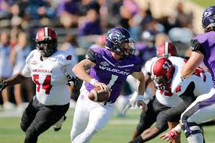

Context Encoder GAN
content loss
Mask
Discriminator
1
0
Fixed Shape InPainting

Slide 6
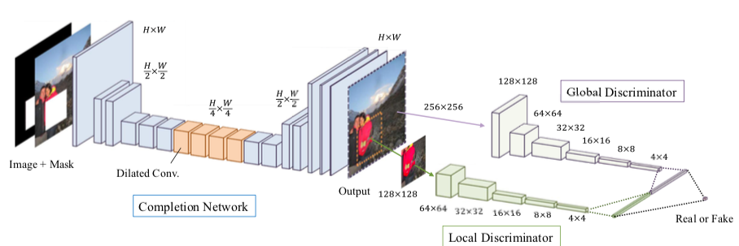
GLCIC Network(PixChef)
Dilated Convolution,（enlarge receptive field)
Global Discriminator + Local Discriminator

Slide 7
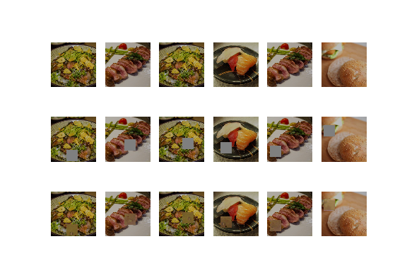
Issues
original
Mask
Generation
生成影響模糊， 失去重點

Slide 8


How..
What/How to fill?
meaningful patches
Hallucination
To Design a Network
Explore Background to find Meaningful Patches
ATTENTION IS ALL YOU NEED!!!

Slide 9
Contextual Attention
hereinafter: CA Model
Generative Image Inpainting with Contextual Attention

Slide 10
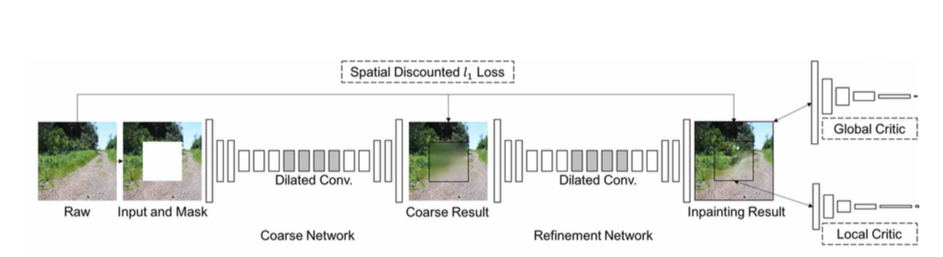
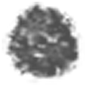
Contextual Attention
Spatially Discounted loss(L1)
Global GAN loss WGAN-GP
reconstruction loss
Improvement
Two Networks:
Coarse Network (Reconstruction Loss)
Refinement Network (Reconstruction +GAN)
ELU + Clip Value
Local GAN loss

Slide 11
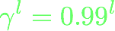
Weighted Reconstruction Loss
Mask
p
p’
Weight =
Less ‘hallucination’ for pixels near Boundaries

Slide 12
Contextual Attention Layer
Learns where to Borrow/Copy info from Background
Differentiable, could be trained as deep model.
Shape free the inferencing via Fully Convolution

Slide 13
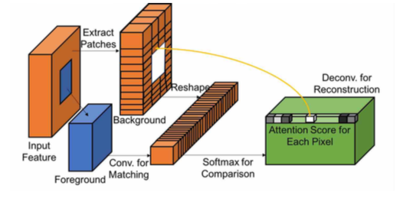
The Architecture
把背景 用 3 x 3 抓patches 出來， 然後一堆 3 x 3 變成filter
把這些filter 與 前景(masked area) 做convolution (size still = 前景, masked area)
做channel wise softmax (with constant)
(注意， 這時候， 每個 前景pixel 值 就是 weight)
* 用 filter 做 deconvolution （意思就是 weight * filter = reconstruct value) (size still = 前景, masked area)

Slide 14
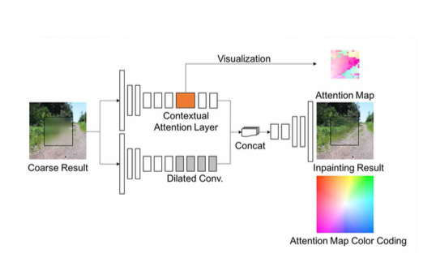
Integrated NN Architecture
Two encoders

Slide 15
Pre-Trained Model Fine Tune
Restarts/Resume Training on Food Data
Repeated Inferencing (Coarse -> Refine -> Super Refine)
Add-on Improvement NN

Slide 16
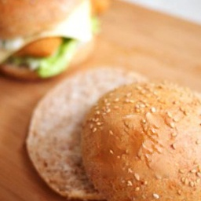
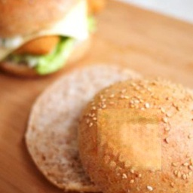
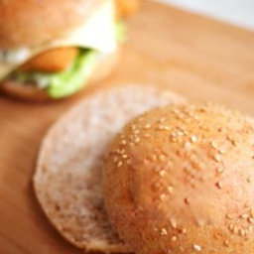
Food Data Resume Training
Base:
(pre-trained: Imagenet)
10000
CA Model Starts from 0
25500
CA Model resume
5400

Slide 17
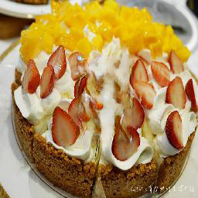
Super Refinement
+
1
2
3
4
Reduce Masks/4
Re-Inferencing *4
1
2
3
4

Slide 18
Add on NN to Improve Quality
Not succesful
DeBlur GAN (非模糊， 而是複雜背景參雜)
Shape Free Improvement (given random size mask, Reduce Style/Content Loss)
Reduce Style/Content Loss)

Slide 19
Add on NN to Improve Quality
Not Succesful
DeBlur GAN
(非模糊， 而是複雜背景參雜)
Shape Free Improvement
(given random size mask, Reduce Style/Content Loss)
Reduce Style/Content Loss)

Slide 20



總是在廢墟中發現花朵。。Style NN
style
style
=
style
noise
noise
………
content
content
=
content
Style Network for every Picture

Slide 21
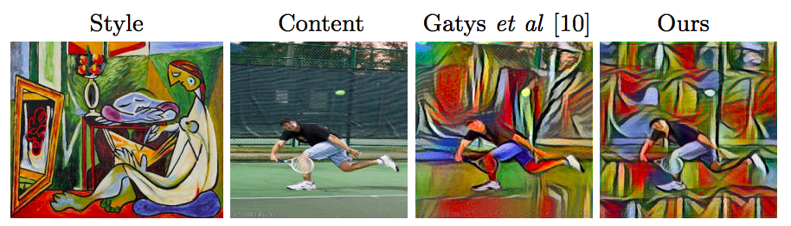
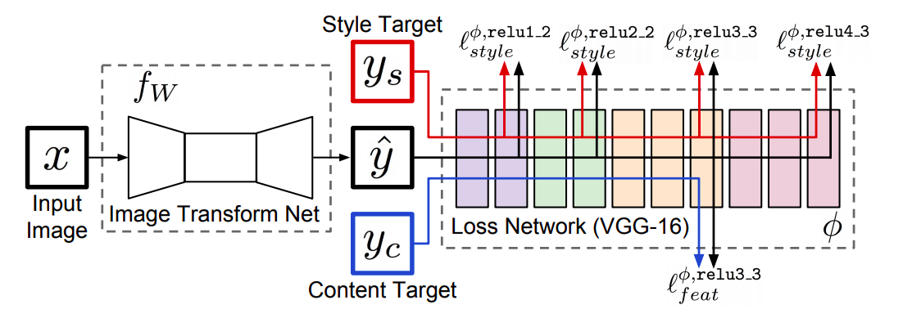
向大師致敬....只能
Perceptual Losses for Real-Time Style Transfer and Super-Resolution

Slide 22
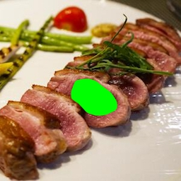
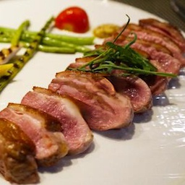
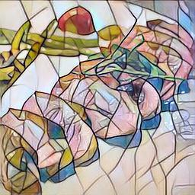
Generation + Style Transfer

Slide 23
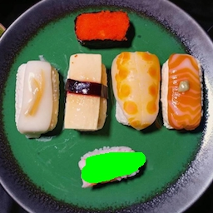
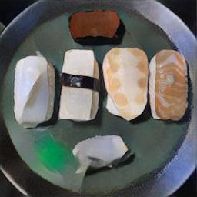
Generation + Style Transfer

Slide 24
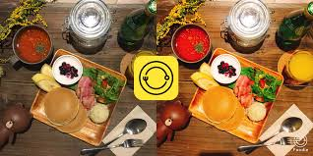


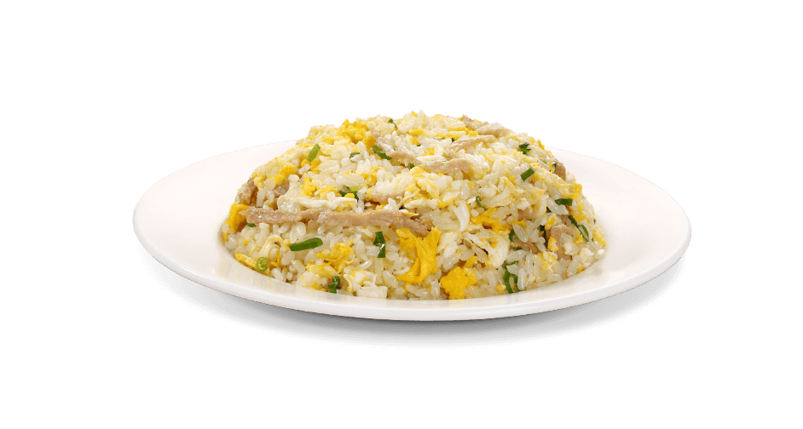
NN for 美味風格
阿宅的美味
一定是轉成燈光昏黃 ?
牛排三分熟
黃金炒飯粒粒清楚
甜在心的甜

Slide 25
MY_SK_ll
睡醒以後， 繼續努力

Slide 26
凡事問Chatbot
請問,請問，
如何可以美味好吃， 讓老僧坐下蒲團也要把持不住， 顏面多有損失!!
GAN: 只要留白填滿YUMMY色彩！何不速速跳牆過來？

